Slide 1



A PRESENTATION ON FINAL PROJECT
DEVELOPING A PHEV FROM NON-HYBRID BASELINE VEHICLE
ARJUN | VIKRANT
MS - MEEM
Michigan Tech University

Slide 2

Group Members
Last Name | First Name | Email
Darbha | Arjun | adarbha@mtu.edu
Chiddarwar | Vikrant | vvchidda@mtu.edu

Slide 3



Goals and objectives
Design a working hybrid model from a baseline Chevy Malibu
Objective of the project (or course) has been reduced fuel consumption (FC) without deteriorating performance
This is achieved by using enhanced technology but, most importantly, HYBRIDISATION
a
b
Notes:
A - http://www.chevrolet.com/2012-malibu-mid-size-sedan/exterior-pictures.html
B - http://www.toyota.com/prius/photo-gallery.html#!photos/10/

Slide 4
Our Car
Vehicle Type: (PHEV)
$ 26,204
Fuel Economy
PHEV
City | 39 | (MPGe)
Highway | 29 | (MPGe)
Combined | 35 | (MPGe)
Fuel/Energy Consumption
Gasoline | 2.76 | (gal/100 miles)
Electric | 5.64 | (kW-hr/100 miles)
Blended | 2.32 | (gal_{e}/100 miles
Range
Electric/Blended (CD) | 42 | (miles)
Gasoline (CS) | 480 | (miles)
Total (CD+CS) | 522 | (miles)
CAFE Composite FE
Combined | 39 | (MGPe)
Annual Fuel Cost
Cost | 1600 | ($)

Slide 5
Are we any good?
Notes:
Histograms/Charts comparing baseline and HEV go in here

Slide 6
How did we get there? (Week 1)
Week 01 – (Sensitivity Analysis)
Kp and Ki in driver subsystem have been adjusted to reduce the number of errors on drive cycle. At the end of first run, Kp = 1.0 & Ki = 0.1.
But, Kp,Ki also sensitive to FC
Different sets of transmission shift logic have been tested and a new set of values determined
Transmission and performance have strong correlation. Hence, performance compliance (through PCF) and 0-100 mph were continuously monitored
Aero drag and Rolling resistance have been changed slightly to match current values on a Malibu
Alternator Gain in IC subsystem reduced by 50%

Slide 7
Week 1 Progress
FC is sensitive to BSFC but BSFC cannot be changed unless engine technology changes
Transmission logic affects FC and also performance

Slide 8
How did we get there? (Week 2)
Model has been validated against advanced technologies discussed in NAE report
CI engine has been modeled – not provided in model presented (bsfc curves and calculation details included in the report)
Impact of mass reduction, different transmission technologies, engine technologies have been tested for FC reduction and cost and values compared against NAE report values
Engine Start-Stop technology has been implemented (drive cycle and engine level) and it has been realized that it has a great potential to reduce FC in urban driving conditions
Regeneration potential has been calculated for different drive cycles

Slide 9
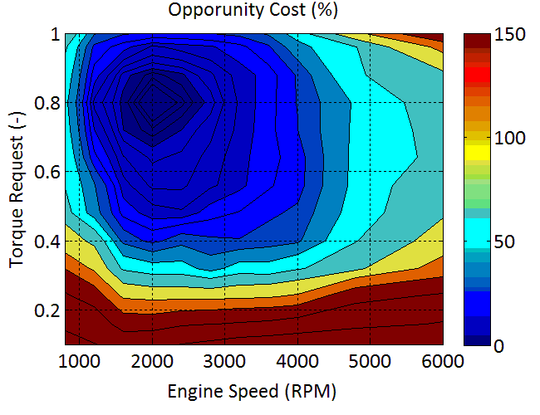
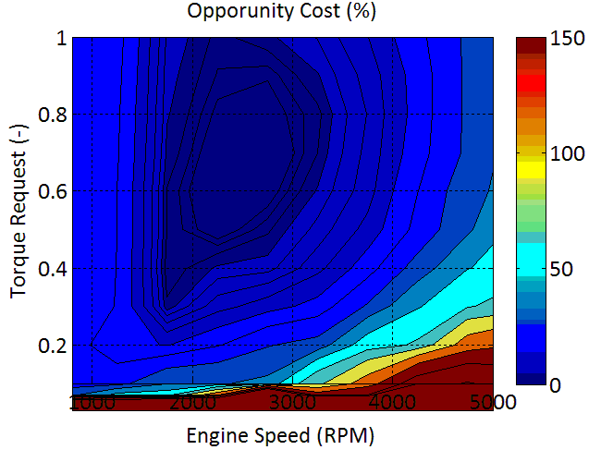
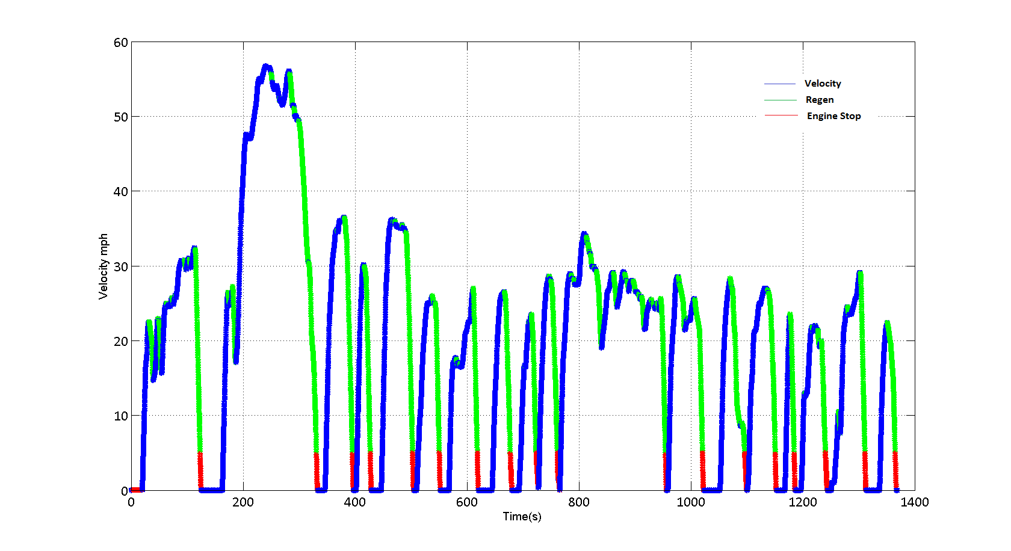
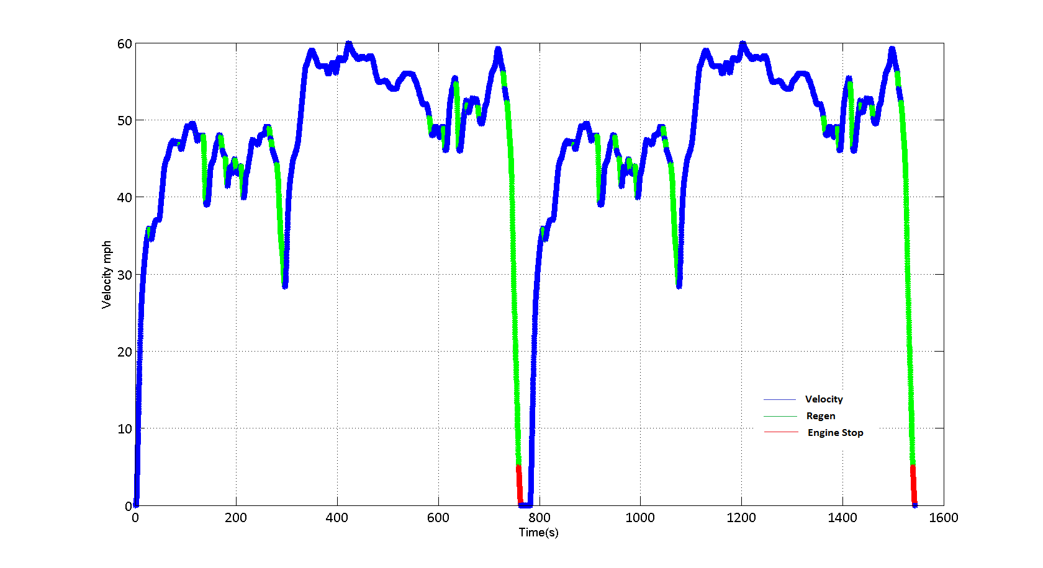
Week 2 Progress
SI 2.4l I4 GDI VVT
CI 2.3l I4 TDI
UDDS
HWFET

Slide 10
How did we get there? (Week 3)
Motor and battery critically analyzed in this week
Three different batteries provided in the model have been analyzed in terms of capacity, energy density and cost.
Battery is also tested by analyzing SOC values at the end of different drive cycles
Three different motors with different power rating have been provided. Each motor is tested in different drive cycles.
As improvement in FE is directly related to degree of hybridization, high power motor (45 kW) is deemed best suited for this purpose
Also, performance deteriorates when a low power motor is used

Slide 11
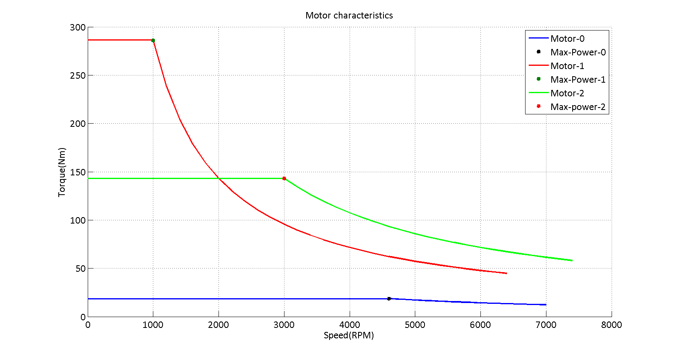
Week 3 Progress

Slide 12
How did we get there? Week 4
Implementation of hybridization has been performed so that maximum FE can be achieved
Broadly, two different approaches have been used synergistically to achieve maximum efficiency
Torque Blend Approach: The motor provides maximum torque at low rpms. This can be used for our benefit
IC Engine speed optimization: Once torque blend is employed, engine is made to operate at the most efficient point
SOC controller: A control strategy is employed to control battery SOC so that it never falls beneath 0.3 (minimum battery SOC)
Regeneration: Limit has been set on regen, no regen below 5 mph and no regen beyond SOC = 1 (overcharging!)

Slide 13
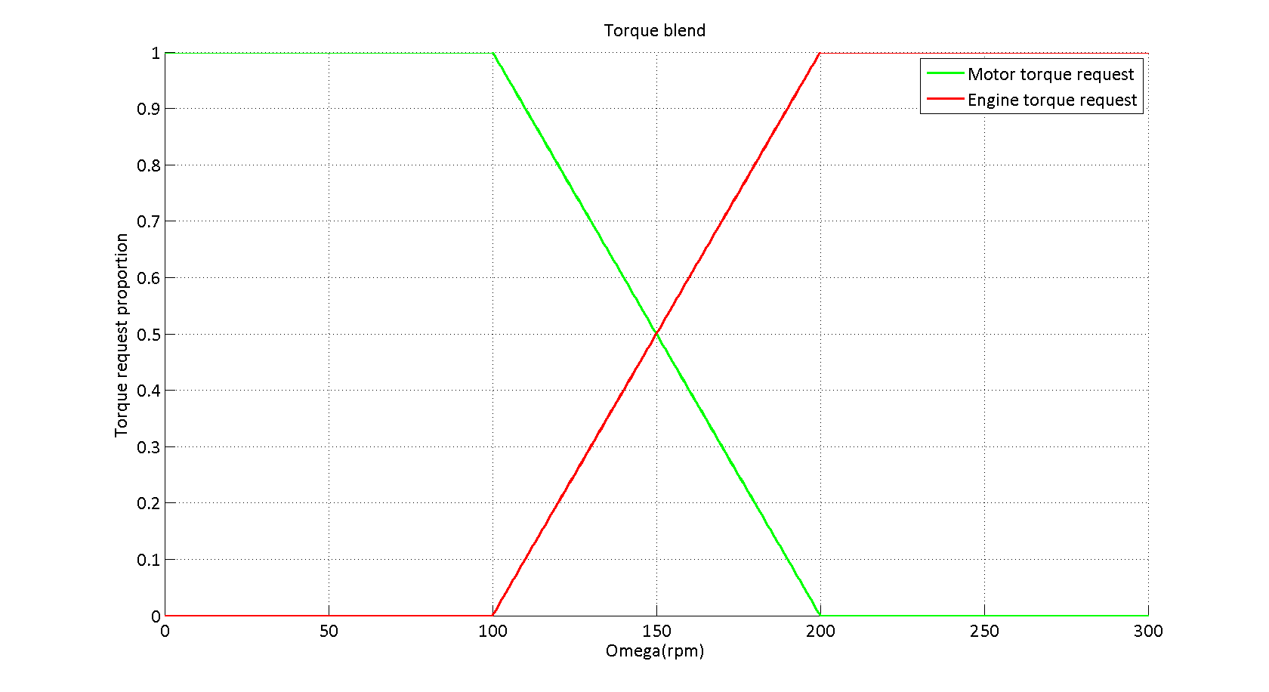
Torque Blend approach
Blend Starts
Engine starts
Blend Stops
As the engine is not efficient in processing torque request(TR) at low RPM, Motor processes torque request in this region

Slide 14
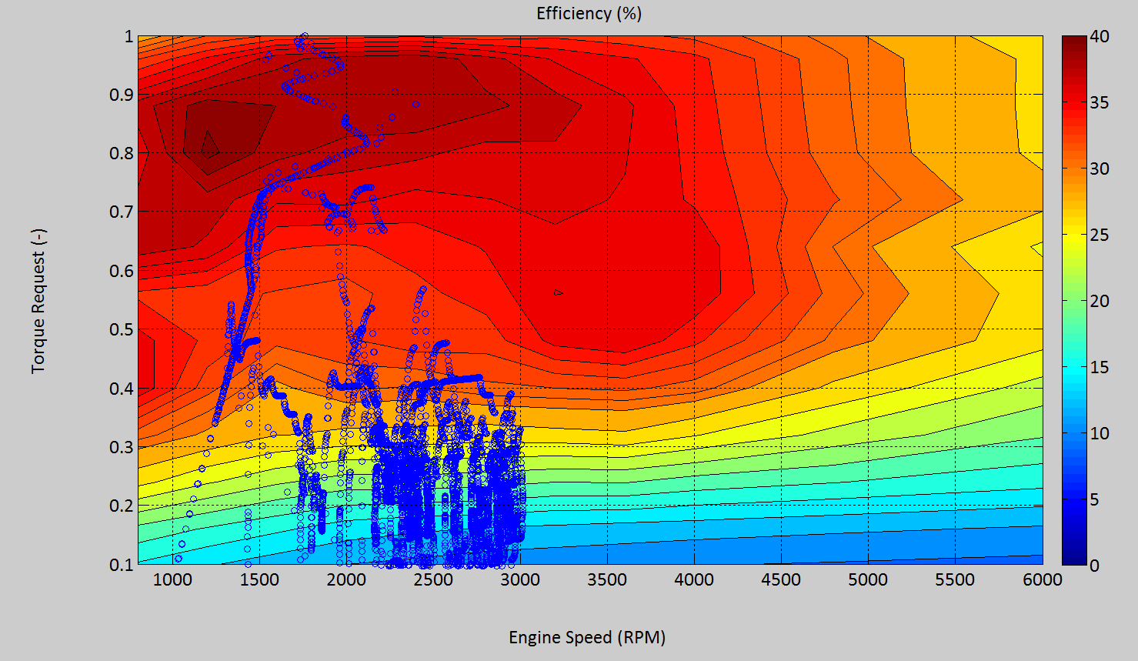
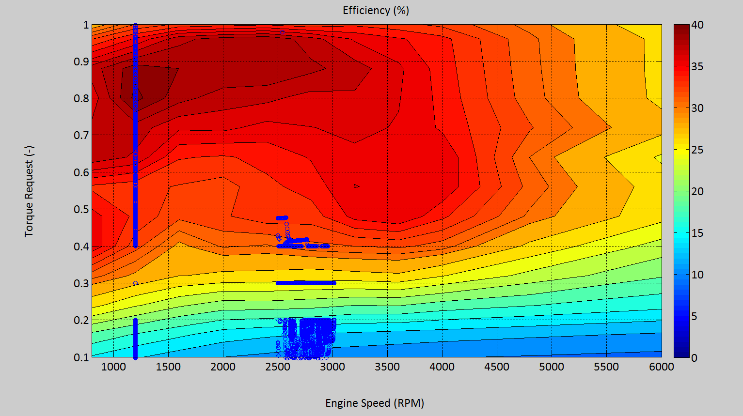
IC Engine Speed Optimization
Vehicle speed is scattered on the
efficiency contour
Engine speed is not controlled in
this case
Engine speed is controlled.
When engine speed is between
0 & 2500rpm with positive TR,
TR is processed at 1200 rpm

Slide 15
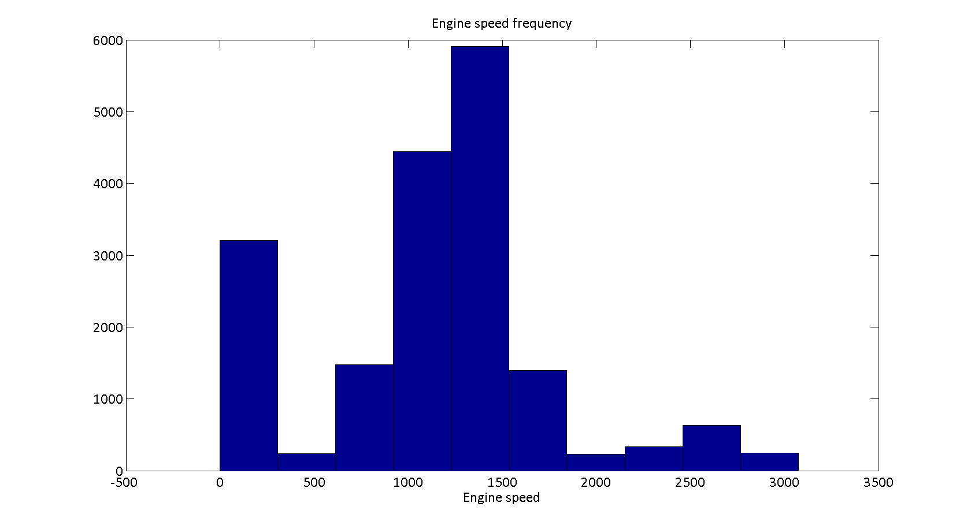
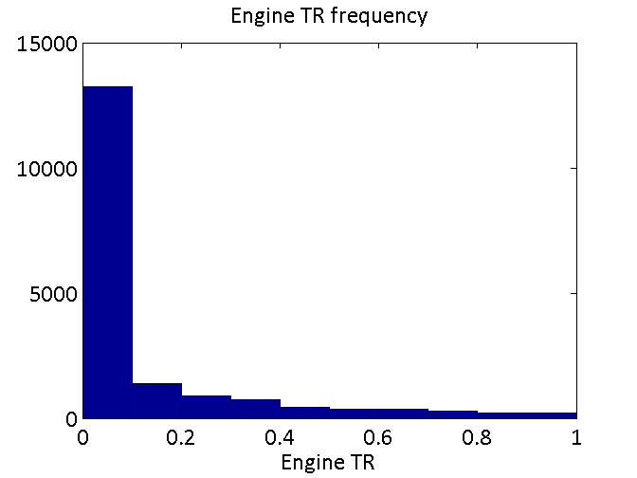
Need for IC optimization
Most engine speeds in UDDS
are in 1000-1500 rpm range
Hence running at an optimal
1200 rpm
Most of the engine TR is
quite low and engine
Inefficient, hence hybridization helps

Slide 16
Thanks for Listening

